Slide 1
About this Class
Introduction to C# programming and software development.
Goal start making things in C#, without being an expert.
Not enough time to teach a lot
Providing lots of examples for you to play with
Designed especially for construction technology professionals
Recommended IDE is “Visual Studio 2022 Community”

Slide 2
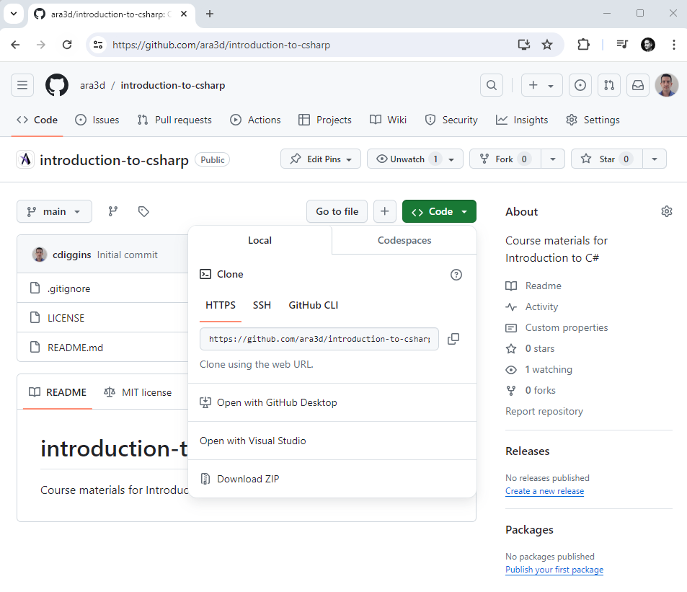
Course Material is Online

Slide 3
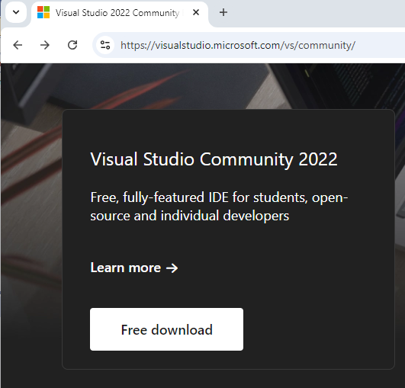
Visual Studio Community 2022
My recommended editor
Free, lots of tools, stable
Downside: Windows only

Slide 4
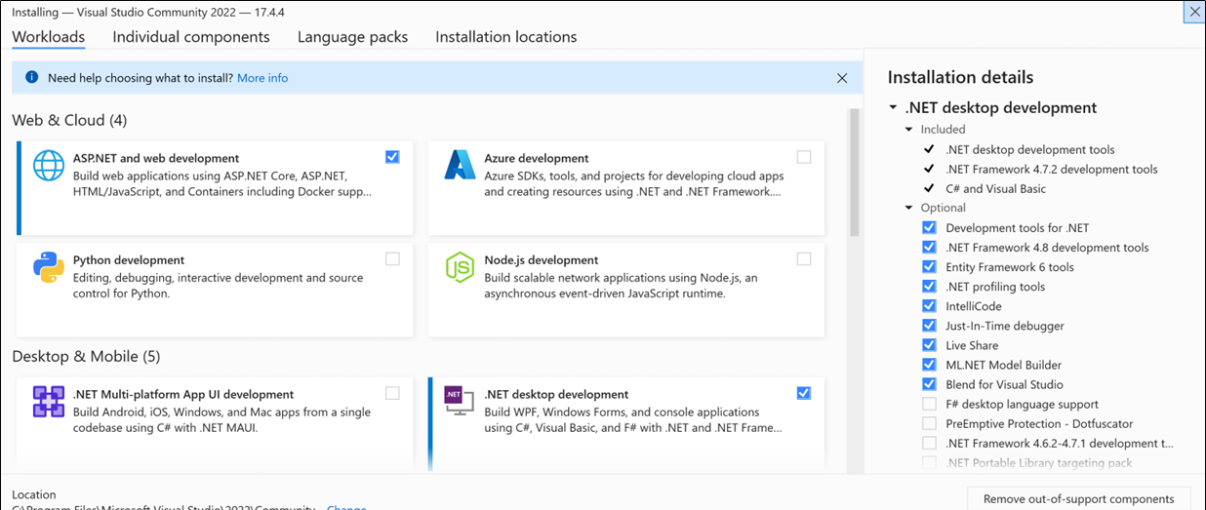
Visual Studio Community 2022
Only choose the .NET desktop development workload

Slide 5

About Me
My name is Christopher Diggins. I operate Ara 3D, a software development company.
Programming computers for 40 years. Some things I might take for granted, stop me if things aren’t clear
I enjoy programming, and I want you to enjoy it as well!

Slide 6
About You?
You are relatively new to programming
Maybe some Python experience
Programming is not your full-time job
You just want to learn quickly
You use Windows

Slide 7
Discuss
Introduce yourself
What is your programming background?
What would you like to learn in the next 3 hours?

Slide 8

About C#

Slide 9

C# Characteristics
Object oriented
Virtually everything is an object (or can be cast to an object)
Garbage collected
Memory is automatically released when no-longer used
Strongly typed
Every run-time value has a fixed type
Statically typed
Every expression and variable has compile-time known type
Reflective
Can query data types at run-time and use fields & methods
Compiles to byte-code
.NET assemblies contain IL byte-code

Slide 10
What is the point of static typing?
Provides a guarantee of safety during compilation
Helps the compiler produce efficient code
Make a program more predictable

Slide 11

Why C#?
Good tooling
Excellent standard library
Lots of 3rd party libraries
Easy to deploy
Cross-platform
Good performance
Stable
Good interoperability
Convenient syntax

Slide 12

C# Project Types we will Cover Today
Console applications
WinForms GUI application (for Windows)
WPF application (for Windows)
Libraries
Unit tests (specifically NUnit)
Unity Scripts [Time permitting]

Slide 13

Let’s Dive Right in

Slide 14
First Examples
Hello world
Writing to console
Main Entry point
Literal Constants
Hello who are you
Reading from console
String interpolation
Variables
Hello Command Line
Exceptions
Command Line Argument
Debugger

Slide 15
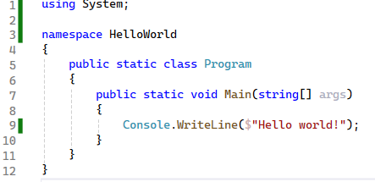

Slide 16
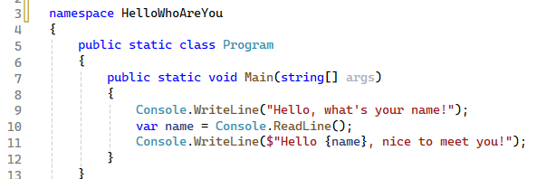

Slide 17
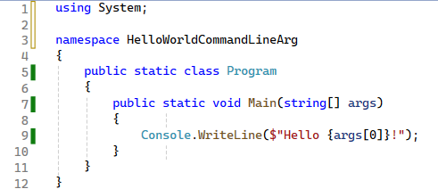

Slide 18
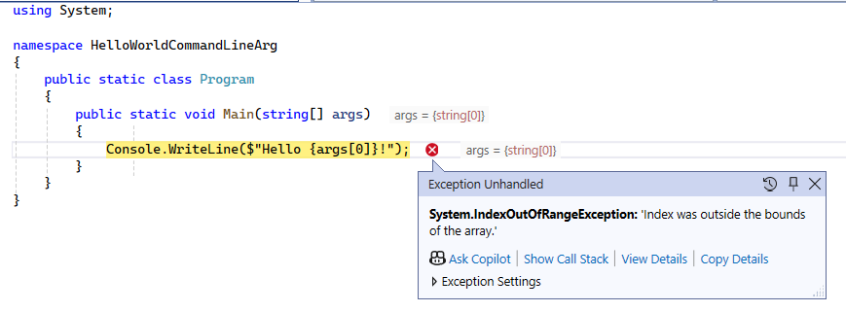

Slide 19
Passing Command Line Arguments
During testing you can put it in the “Debug Properties”
You can call it manually from command-line

Slide 20
Notes about Strings
They represent text in a computer program
Are collections of 16-bit characters
Can be indexed, they have a length
Are immutable: cannot be changed

Slide 21
Things to do with strings
Get number of characters
Get a character or substring
Construct a new one
Split it into an array of strings
Check if it contains, starts with, or ends with a sub-string
Convert to lower-case / upper-case
Replace characters
Read from or write to file
Parse as Numbers
Notes:
These are all easily expressed in code, using Chat GPT.

Slide 22

What you can’t do to a string
Change it.
Notes:
Is it clear what we do, if we can’t change it?

Slide 23

Null versus Empty String
A null string is one that has not been constructed
An empty string is constructed, but has zero length
Accessing methods on a null string will cause an error

Slide 24
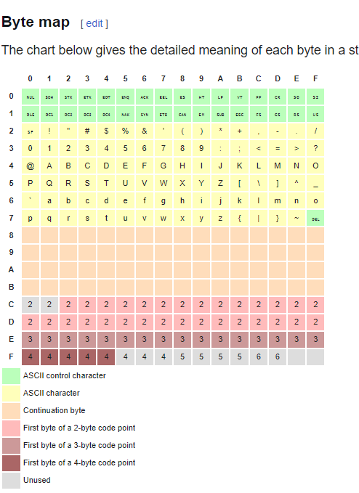
Notes on Encoding
Characters are just numbers
Those numbers map to glyphs based on encoding
Example encodings:
ASCII
EBCDIC
Utf8
Utf16
Latin1

Slide 25
Adding a List of Numbers Together
Write a program that adds a list of numbers together
Notes:
Is this enough information? How do we go about tacking this?

Slide 26

Refine the Problem (Gather Requirements)
Where do the numbers come from?
How many numbers?
Where does the result go?

Slide 27

Consider the Solution Components
How to convert from text into numerical form
Where to store the numbers
How to add them up
How to read them
What to do if an error occurs
What kinds of errors can occur
How to signal the end of execution

Slide 28
Things we need
Conditional Statements
Loop Statements
Error Handling
Converting Text to Number
Collection type
Number type

Slide 29
Collections
A collection is a value that contains other values.
A collection has items of the same type.
Examples include string, arrays, stacks, set, dictionaries, and lists.
We can get far with just using lists and dictionaries
Collections can be enumerated (support foreach)
Notes:
I used the word “collection” earlier.

Slide 30
Indexing
Lists, Arrays, and Strings use an integer index for each item
Indices start at 0
You can retrieve an item: myList[index]
You can (sometimes) modify an item at a position: myList[index] = 12
The last item in a list is: myList[myList.Count – 1]

Slide 31
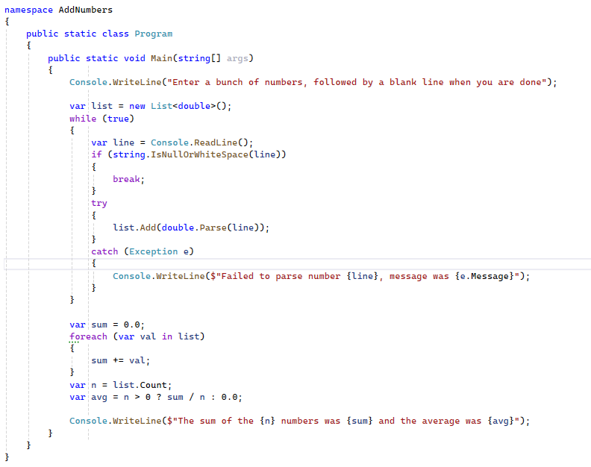

Slide 32
The Secret Life of Console Applications

Slide 33

About Console Applications
A console application (by default) has no GUI
Aka “Command Line Interface” or CLI program
Can be executed with or without a console
Usually reads from standard input stream
Writes to standard output and error streams
Has command line arguments

Slide 34
Example Console Applications
Find
Sort
More
Type
Dir
Echo
Git

Slide 35

Common Command-Line Programming Tasks
Read or Write to a File or Stream
Respond to network requests
Perform a Computation
Launch a Process
Examine/set environment variables
Parse command-line arguments

Slide 36
Why learn about Console Applications
Putting small programs together can be useful
Helps with debugging and testing
Provides different ways of thinking about applications
In .NET every executable, can also be a library

Slide 37
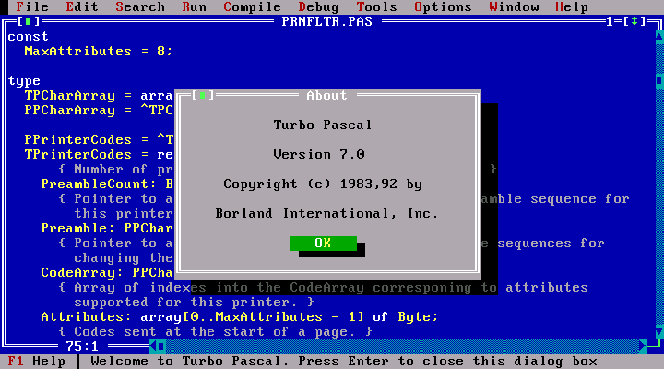
Technically – Can still Draw
Terminal emulators, such as cmd.exe, interpret special characters generated from standard stream as instructions for displaying output
See the “ConsoleDrawing.exe” Demo

Slide 38

Discuss
How can we communicate with a command-line application

Slide 39
Console Application Inputs
Standard Input
Pipes
Sockets
Environment Variables
Command Line Arguments
Files

Slide 40
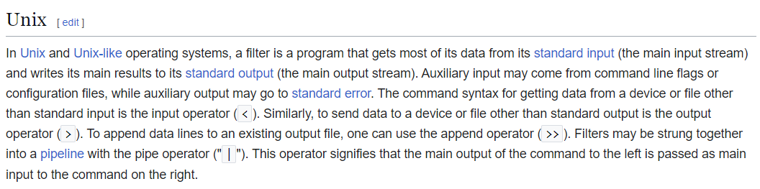

Slide 41
The Unix Philosophy (1978)
Do One thing Well
Make each program do one thing well. Build afresh rather than complicate old programs by adding new "features".
Program Output is other Program Input
Expect the output of every program to become the input to another unknown program.
Try Code Often and Early
Design and build software, to be tried early. Don't hesitate to throw away the clumsy parts and rebuild them.
Notes:
An operating system is one of the most complex software systems that you can develop.
This is the guide book for making Unix.

Slide 42
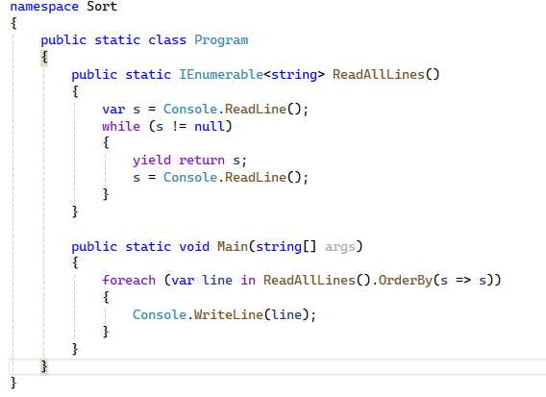
Sort Example
Reads lines until end of input
Input can be read from
Console
File
Another program

Slide 43
Examples
Dir
Dir /b
Dir > test.txt
Find “IFC”

Slide 44
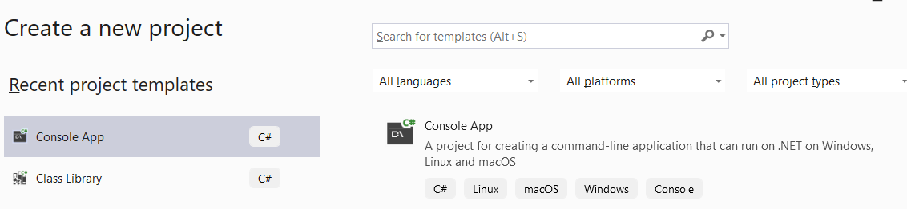
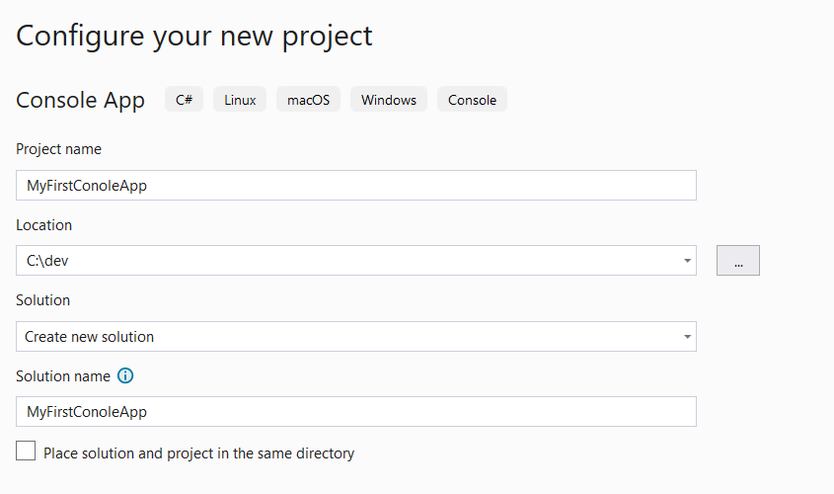
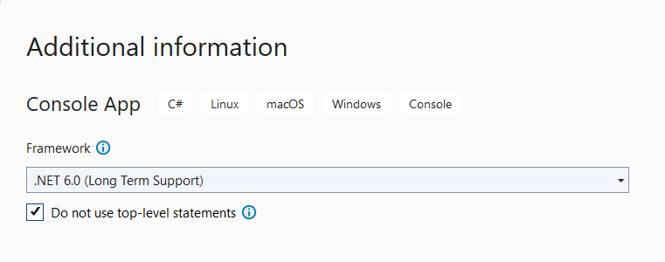
Let’s Make a Console Application
2
1
3
Notes:
We are going to do this together, once everyone has it installed.

Slide 45
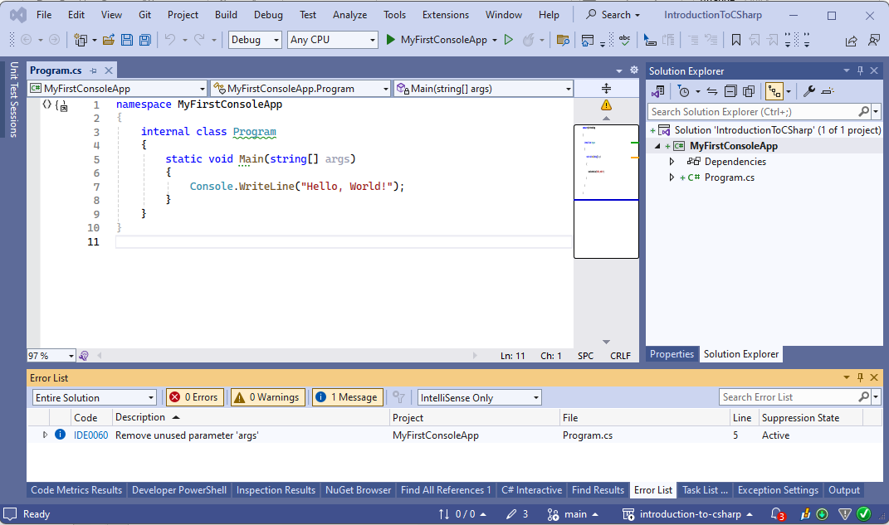
What you will see …

Slide 46
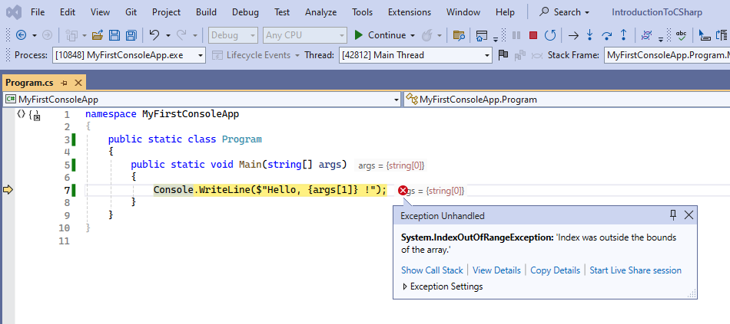
My First Error

Slide 47
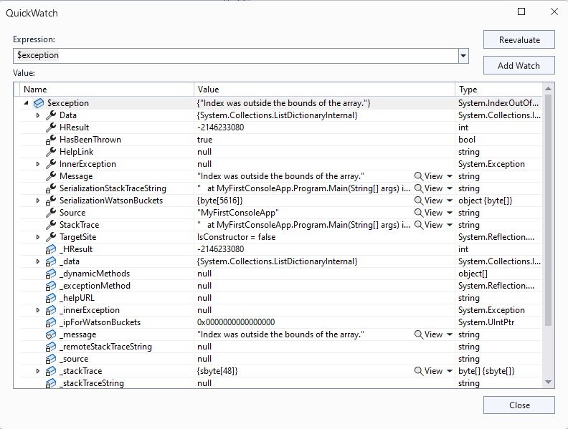

Showing Details shows us Much Details

Slide 48
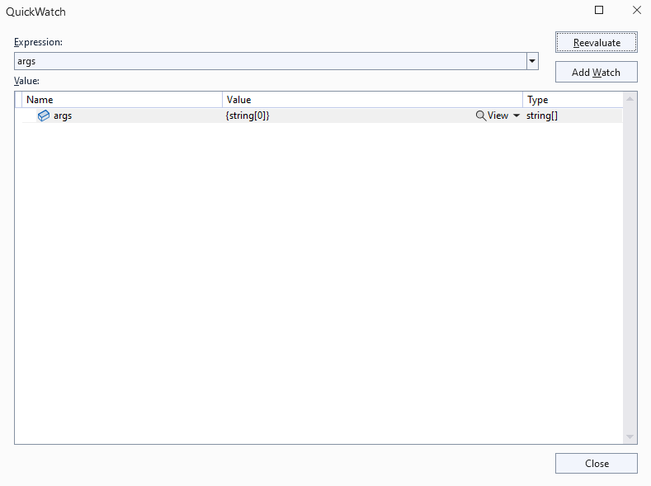
Changing the Expression gives us more clues

Slide 49
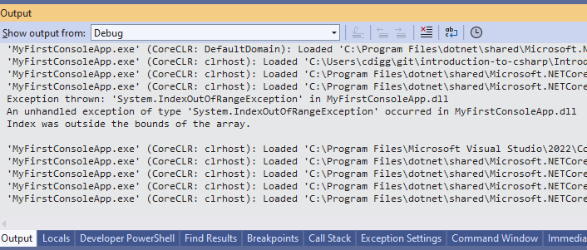
Okay I get the point

Slide 50
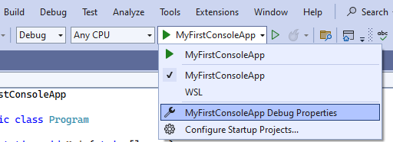
But why? The answer lies in debug properties

Slide 51
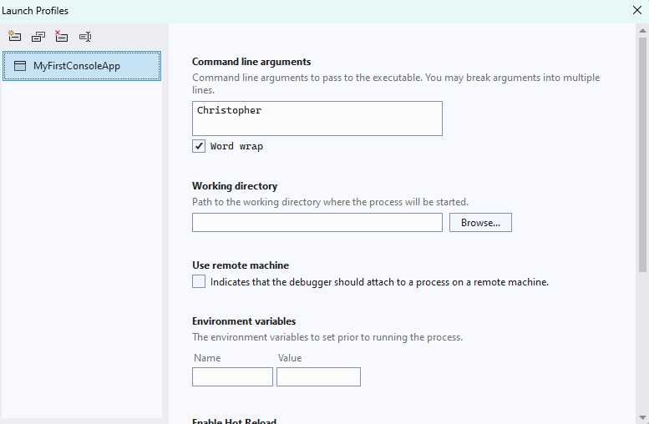
We can specify command line arguments, working directory and environment variables.

Slide 52
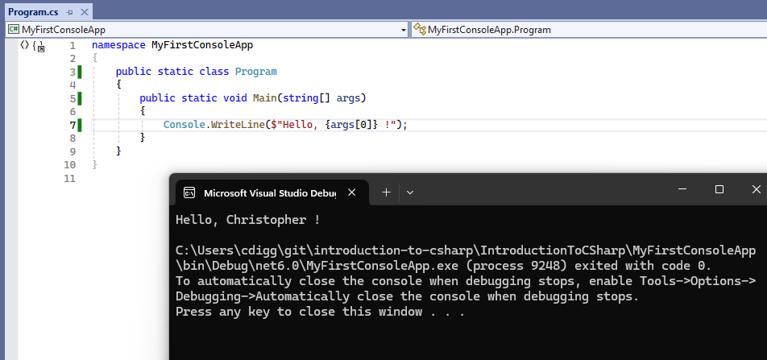
Woohoo, some success!

Slide 53
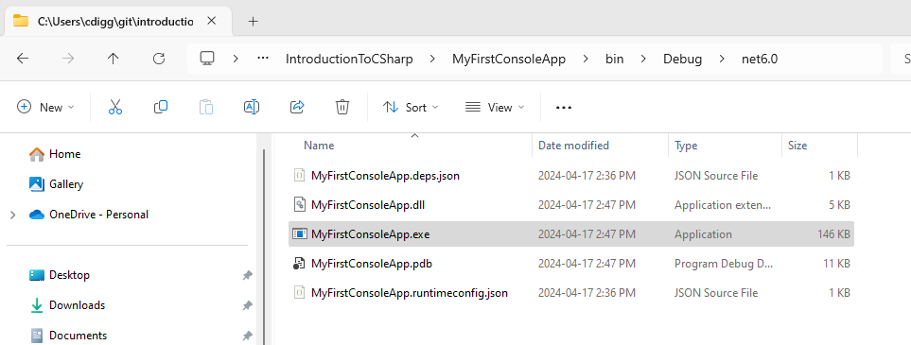
The generated files

Slide 54
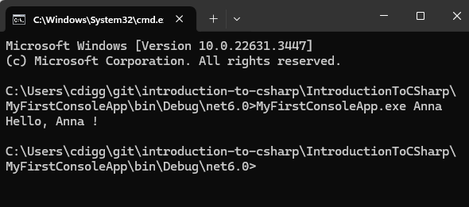
Which we can run from “cmd.exe” (aka the command line)

Slide 55
What is a Stream
A sequence of data made available over time
Represents a data source or data sink
The next value might not be ready for a while
Streams are potentially infinite (codata)

Slide 56

Standard I/O Streams
Relevant from any language and OS
Can be used with shell scripts (DOS batch)
There are three:
std in
std out
std err
Used by OS to redirect input/output between files and processes
Look like and are interchangeable with files

Slide 57

C# Launching a Process and Redirection
Launching a process
Redirect standard-input of process
Redirect standard-output of process
Redirect standard-output of current program

Slide 58
C# Streams
A stream is a read-only or write-only sequence of data
Usually, characters or bytes
StreamWriter writes characters to a stream
StreamReader reads characters to a stream
Console.WriteLine() writes to standard output
Console.ReadLine() reads from standard input
Streams are opened or closed
Usually unidirectional (can’t back up unless buffered)

Slide 59
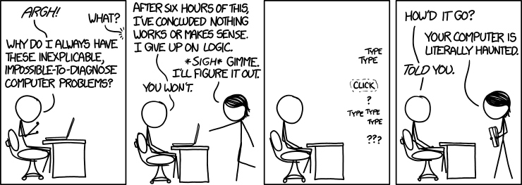
Debugging (and a bit of testing)
https://xkcd.com/1316/
By Randall Munroe

Slide 60

Bugs don’t exist 🐛
There are no bugs
Just confused programmers …
… who wrote confused code
Computers do exactly what they are told.

Slide 61

Debugging
Don’t delay learning debugging tools
It speeds up development and learning.
C# makes it very easy
This is my reason for preferring C#

Slide 62
Breakpoints and Pausing Debugger
A marker assigned to a statement that triggers debugger to pause.
Exceptions also can trigger debugger pauses
Programmatically you can use:
Debugger.Break() to pause
Debugger.Launch() to launch and attach debugger

Slide 63
Stepping Through Code
When debugger is paused you can step through code
Resume execution
Pause execution
Stop debugging (usually stops program)
Restart execution from beginning
Step over any function calls
Step into any function calls
Step out of current calls

Slide 64
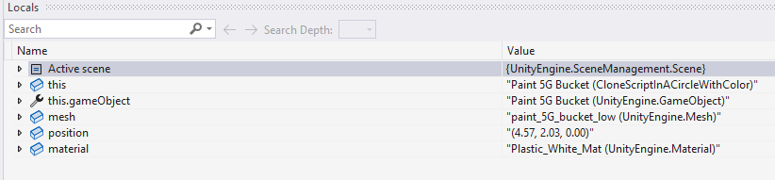
Watches
A window that shows the value associated with an expression.
We can view all local variables or specific expressions.
For more information on using watches see this article.

Slide 65
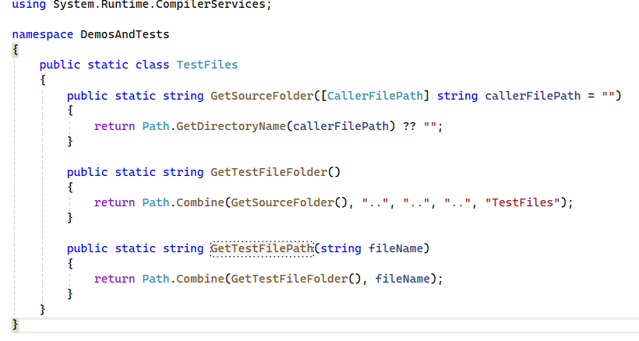
Get the Folder of Source

Slide 66
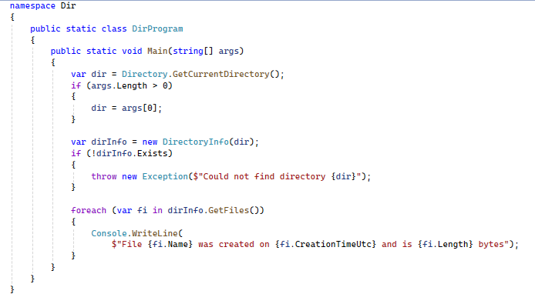
A Simpler Dir

Slide 67
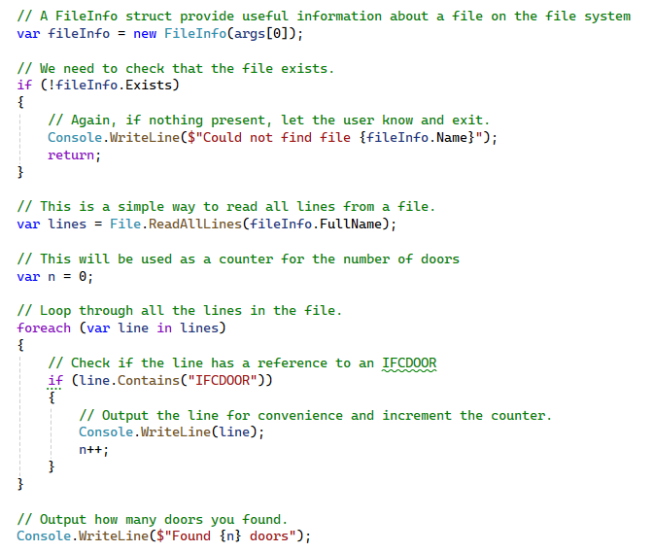
Reading a File

Slide 68
Tests Projects! 👩‍🔬
Tests are a powerful debugging tool
Check functions do what you think they should
Can be used to do exploratory coding
Useful for one-off tools, without creating a project

Slide 69
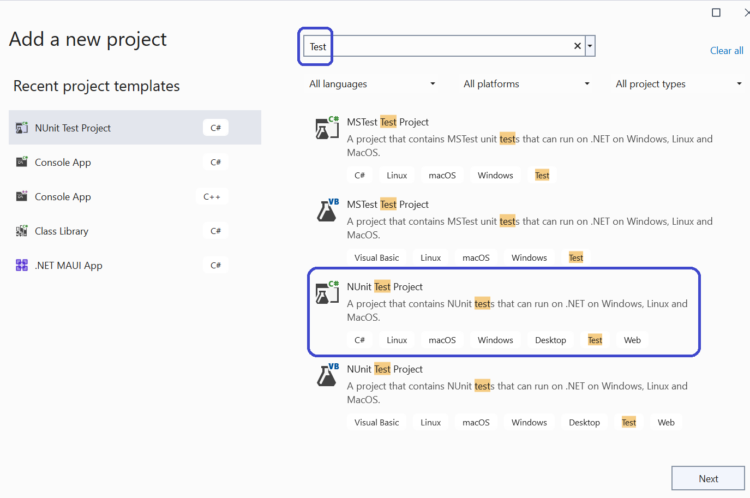
Test Projects: A special kind of library

Slide 70
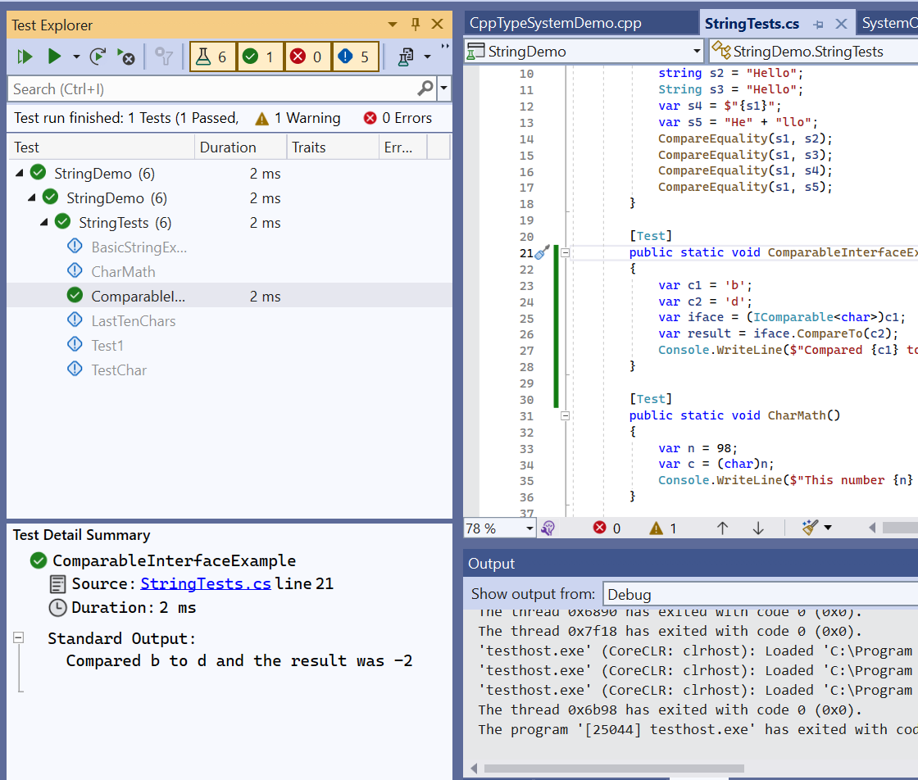
The Test Explorer Window

Slide 71
Using Tests as Tools
Mark the test as “explicit”
Example of launching a process.
Some tips and tricks:
Getting the “caller” folder
Using a set of files as inputs

Slide 72
Advice
Start with tests early
Don’t be afraid to throw away tests

Slide 73
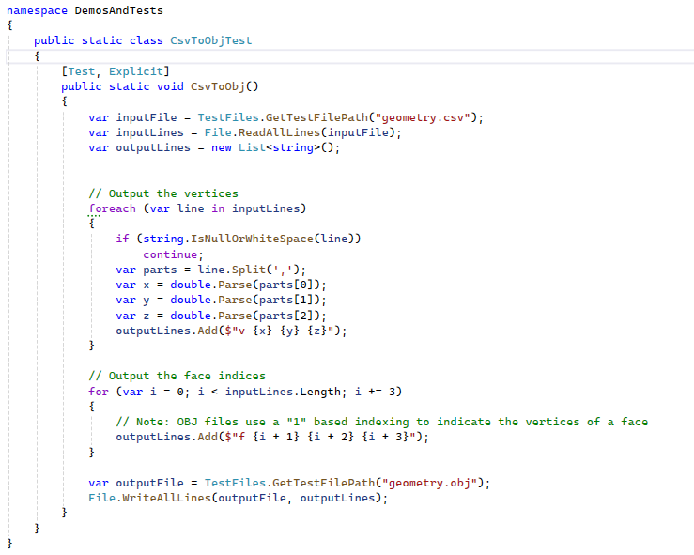
CSV to OBJ

Slide 74
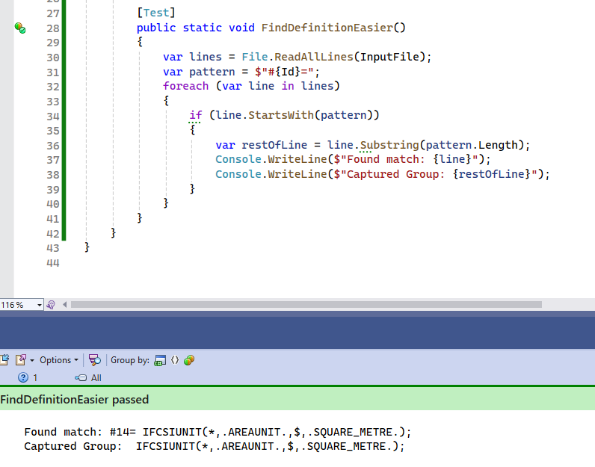
Pattern Matching

Slide 75
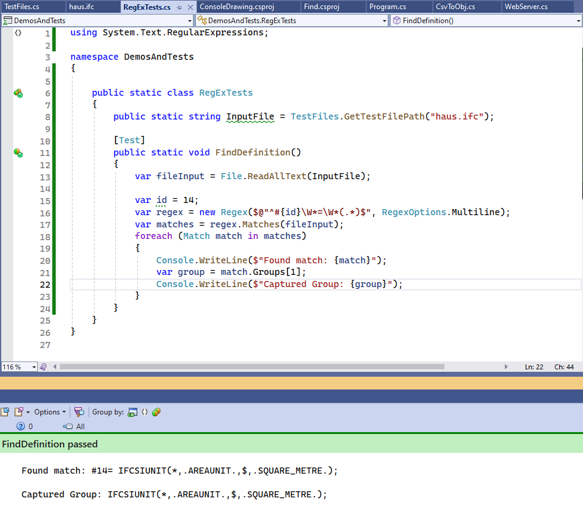
Using Regular Expressions

Slide 76
Understanding the Regular Expression String
$@"^#{id}\W*=\W*(.*)$"
$ = We are doing string interpolation
@ = Verbatim string `\` doesn’t require `\\` as usual in strings
^ = Matches beginning of string (or line)
{id} = Insert the string representation of the variable `id`
# = Part of the pattern we are searching for.
\W* = Matches zero or more whitespace character
( ) = Signifies a “capture group”
.* = Match as many characters as possible
$ = Matches end of string

Slide 77
When to use Regular Expressions?
For complex patterns and conditional logic
Never required, just sometimes convenient
Downside is, can be hard to understand and validate

Slide 78
Pipes Demo
Pipes
Threads / Tasks
StreamWriter
StreamReader
Disposable

Slide 79
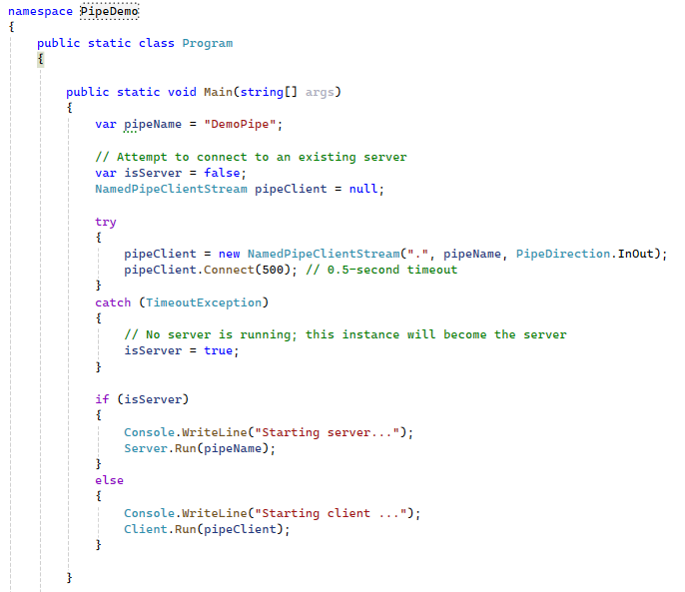
Pipe Demo Program

Slide 80
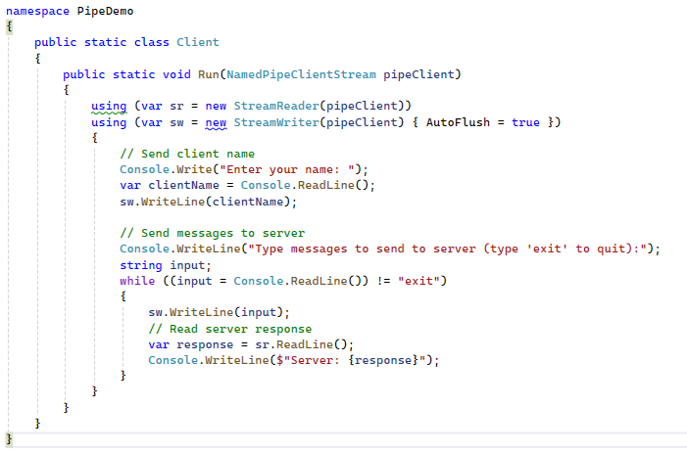
Pipe Client

Slide 81
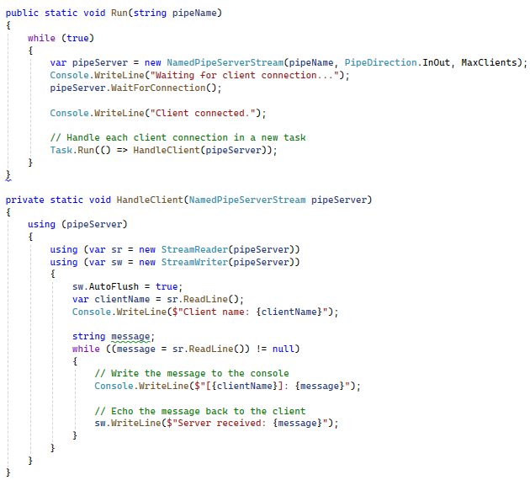
Pipe Server

Slide 82
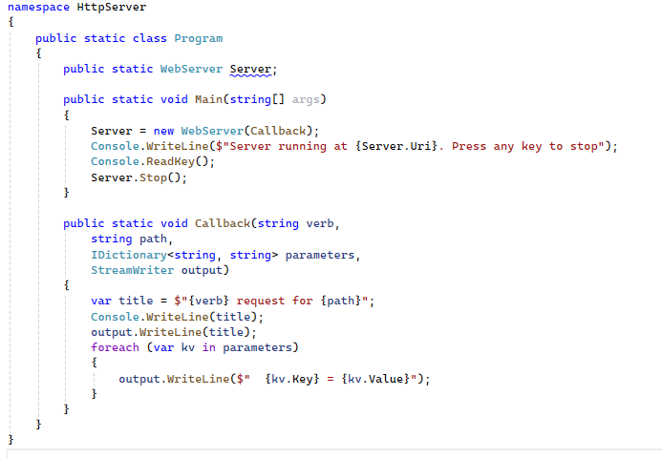
Instantiating a Simple Web-Server

Slide 83
Notice:
Multi-threaded
Works, even though it is waiting for a user to press a key.
Uses a callback
A function provided by the user
Callback is passed an IDictionary
Contains key / value pairs representing the URL parameters
Callback is passed a StreamWriter
Which is used to return the response.

Slide 84
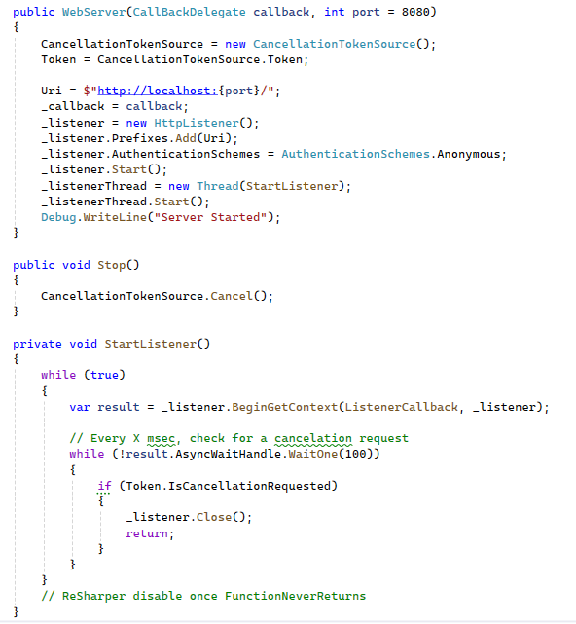
Under the Hood

Slide 85

The Basics of a Graphical User Interface
A GUI executes within the context of a window manager.
A hidden loop dispatches windows messages to your code.

Slide 86
Choosing a C# GUI
WinForms is quickest to learn and start using.
For Windows only .
WPF is significantly more powerful and flexible
For Windows only
MAUI is a cross-platform mobile app UI framework
A successor to Xamarin
ASP.NET
For web-based UI
3rd party options:
Avalonia UI - https://avaloniaui.net/
Uno - https://platform.uno/

Slide 87
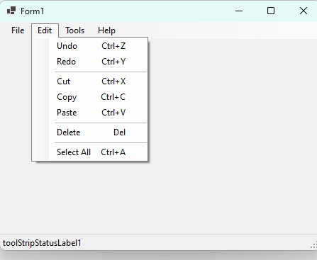
WinForms is from 1995 … but so what?

Slide 88
Using Events
Events are functions you write called in response to user input
Also called callback functions or delegates

Slide 89
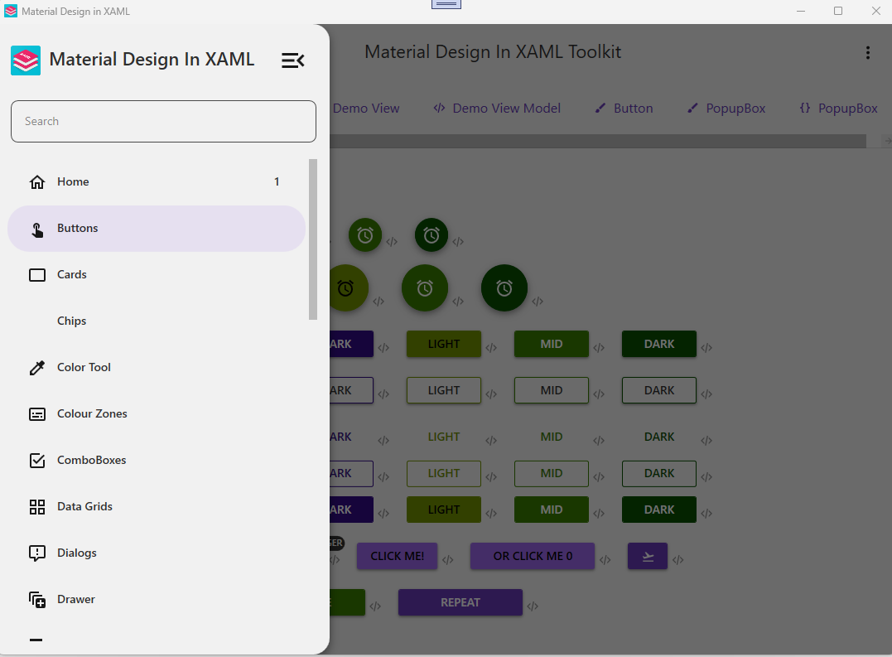
WPF is more modern (somewhat) and flexible

Slide 90
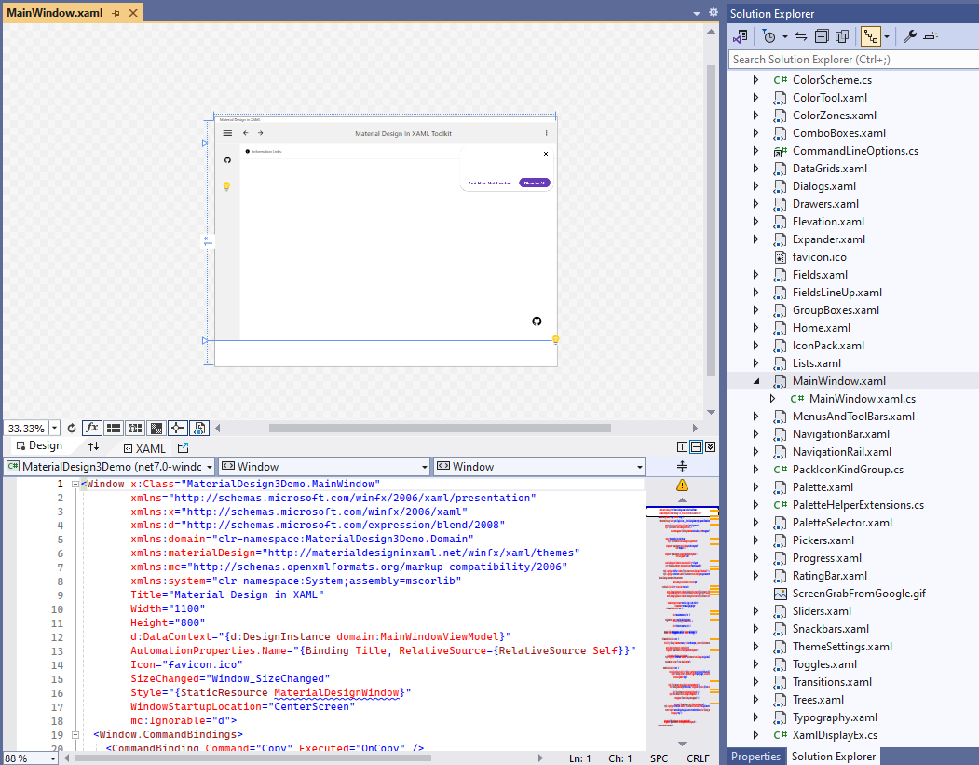
Windows Presentation Framework (WPF)
Uses XAML to express layout and basic UI concepts
Uses data-binding to decouple presentation from business logic
Also very old, but still more modern than WinForms
Currently best option for Windows desktop UI

Slide 91
Data Binding
Based on a generic event
INotifyPropertyChanged
Has one event handler
Called by data model whenever data is changed
For example: via a property
UI controls listen to event and retrieve new values from properties
Uses reflection magic

Slide 92
XAML
An XML based declarative language
Specifies relationships and properties of graphical components
Maps to constructors and initializers in code behind
Has special embedded language for expressing bindings

Slide 93
Code Behind
This is the code that is generated from XAML files
Instead of using XAML we can use code-behind
It can beeasier for new programmers

Slide 94
Two Meanings of Stream
A file, socket, pipe, device
“File-like” things. In C it would be a FILE*
An enumerable sequence of data
Something you can enumerate with foreach

Slide 95
IEnumerable<T>
An IEnumerable<T> is a generalization of collections
Enumerating means visiting each item in order one by one
Allows you to use foreach loops on a data type.

Slide 96
About the IEnumerable Interface
Most collections support IEnumerable
IEnumerable is a read-only stream ADT
It has limited capability
Allows you to use foreach

Slide 97
Basic IEnumerable<T> (LINQ) Methods
Select – Create new sequence by transforming each item into a new one using a function
Where - Filter a sequence by checking against a conditional function (predicate)
Aggregate - Combine elements of a sequence using a function (generalization of sum)
Zip – Combine elements between two sequence pairwise to create a new one.
Notes:
https://learn.microsoft.com/en-us/dotnet/api/system.collections.generic.ienumerable-1?view=net-8.0

Slide 98
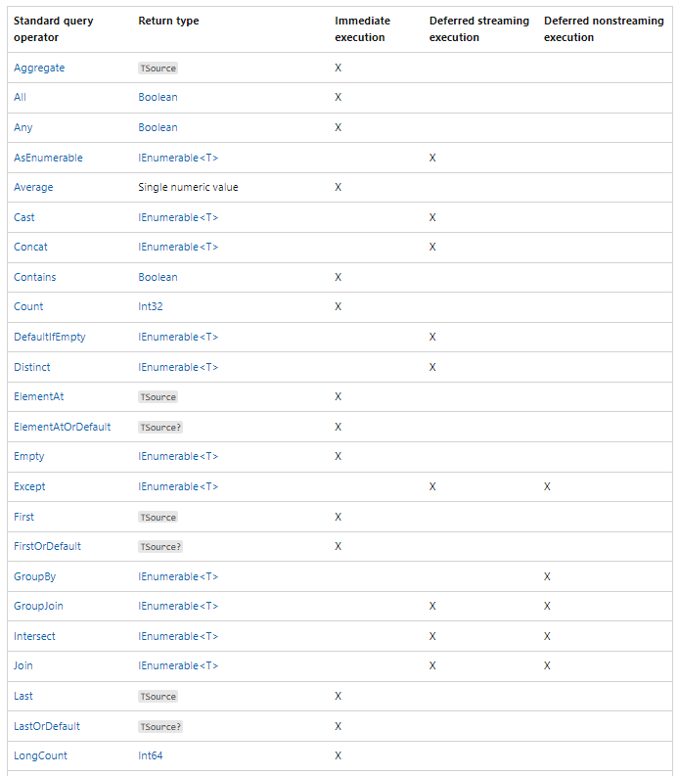
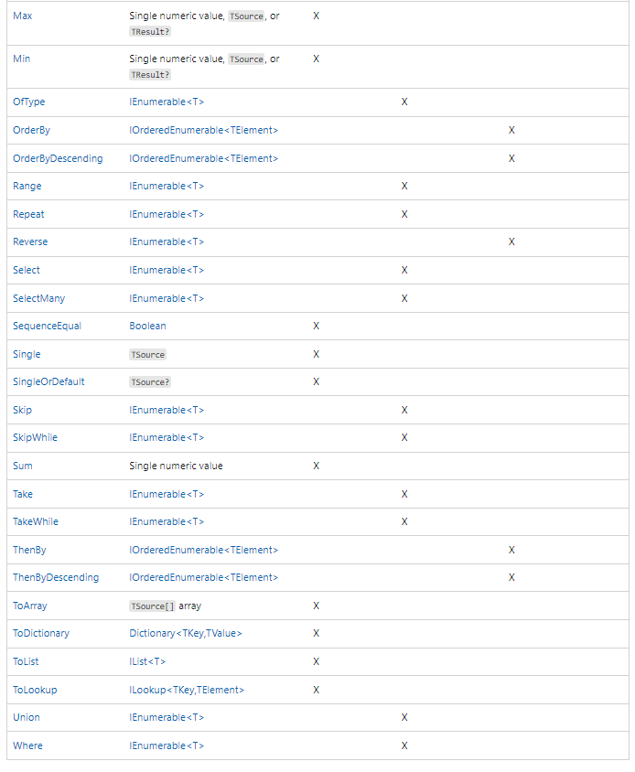
Even more LINQ Operations https://learn.microsoft.com/en-us/dotnet/csharp/linq/get-started/introduction-to-linq-queries

Slide 99
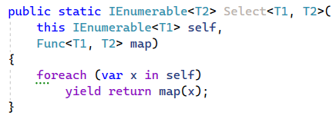
Select as Generator

Slide 100
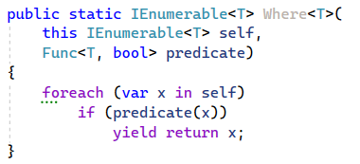
Where as Generator

Slide 101
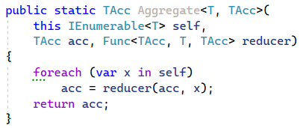
Aggregate as Generator

Slide 102
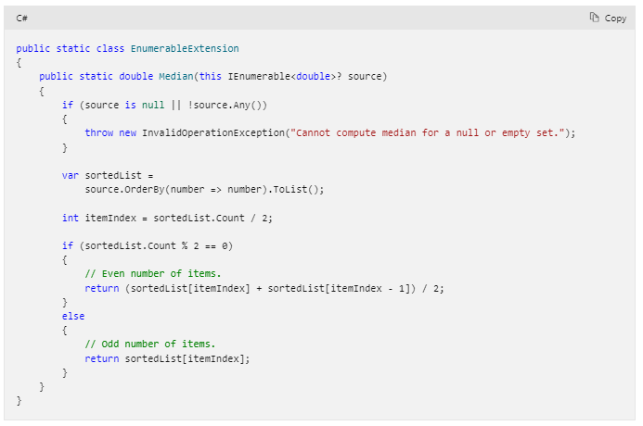
Extension Methods

Slide 103
Programmers are the root of all complexity
… that and mutable state.

Slide 104
Objectives
Understand how you can make coding easier
Or rather, stop making it harder

Slide 105
Effective Programming
The secret to being an effective programmer is that we don’t have to remember the details, because we can create well crafted functions and data types that hide the details of how to do things, and instead describe what we want to achieve.
This is the hallmark of a style of programming called functional programming, and it results in code that is easier to understand and refactor.

Slide 106
The Unix Philosophy (1978)
Do One thing Well
Make each program do one thing well. Build afresh rather than complicate old programs by adding new "features".
Program Output is other Program Input
Expect the output of every program to become the input to another unknown program.
Try Code Often and Early
Design and build software, to be tried early. Don't hesitate to throw away the clumsy parts and rebuild them.
Notes:
An operating system is one of the most complex software systems that you can develop.
This is the guide book for making Unix.

Slide 107
Use many Small Functions
Easy to understand
More likely to be reusable

Slide 108
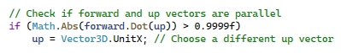
How could this be improved?

Slide 109

How about this?

Slide 110
More Data Structures
If you are passing around multiple parameters
Why not bundle them together?
Instead of:
Do this

Slide 111

May seems insignificant, but
Now you can have an implicit cast
A function can easily return it
Less documentation is required
Notes:
Little differences add up. When I code review for my colleagues, they think I’m obsessive.

Slide 112
Why is code reduction good?
Less possibility of mistakes
Fewer tests to write
Easier to understand and debug
Easier to maintain and modify

Slide 113
Continuous Refactoring
While writing code, ask yourself:
Is there a simpler way to do this?
Is there a function that would make this easier to read and write?
Am I repeating myself?
Are there too many parameters?
Is there a data structure that would make this easier to work with?

Slide 114
Programming Principles
Make it as easy to understand as possible
Code for People not Computers
Describe the Problem, not the Solution
What you think is obvious, is not to other people
Notes:
What you think is clear Is surprisingly confusing to other people.
Describe the Problem, not the Solution

Slide 115
Linking to Libraries
Reference projects
1
Install packages using Nuget
2
Link managed assemblies (DLL / EXE)
3
Call native libraries using PInvoke
4

Slide 116

Nuget – C# Package Manager

Slide 117

Writing Class Libraries
Writing class libraries are a secret weapon
Putting code in a library simplifies problems
Provides opportunity to reuse solutions
Saves time and reduces complexity

Slide 118

Use .NET Standard 2.0 for Compatibility

Slide 119
Last Seven Years of .NET / C#
C# Version | Date | .NET Framework | .NET / .NET Core | .NET Standard | Unity
7.0 | March 2017 | 4.7 | .NET Core 1.1 | 2.0
7.3 | May 2018 | 4.8 | .NET Core 2.2 | 2.0 | 2018.3
8.0 | September 2019 |  | .NET Core 3.1 | 2.1 | 2020.2 (partial)
9.0 | November 2020 |  | .NET 5.0 |  | 2021.2 (partial)
10.0 | November 2021 |  | .NET 6.0
11.0 | November 2022 |  | .NET 7.0
12.0 | November 2023 |  | .NET 8.0
Notes:
What Version to use? - When in doubt, use C# 7.3 and compile libraries with .NET Standard 2.0. Works with the widest range of tools and environments. Especially when you want to do plug-in development and support older Windows tools, or versions of Unity.

Slide 120


Ara3D.Utils
I have a ton of libraries
They make my life easier.
They are my “Batman utility belt”

Slide 121
Takeaways
Libraries and tests are secret weapons
01
Learning 20% of the language and tools can be sufficient
02
Practice, practice, practice
04
Tests are a great way to do exploratory coding
03

Slide 122
C# Scripts
Within Unity

Slide 123

Class
A class describes a particular type of object.
What data it contains
What operations it has

Slide 124
Using Declarations
The using declaration says what library parts are used in the current file.
Extra functionality is provided by libraries.
Libraries are organized using namespaces.
For example: two things called “List” might exist in different libraries.
Namespaces disambiguate.

Slide 125
Inheritance
In Unity all scripts are classes that inherit from a Unity class called “MonoBehavior”.
This means that the things that a MonoBehavior can do, and the values that it contains, are accessible to the new class.
This is called inheritance and is a feature of object-oriented programming (OOP).

Slide 126
Comments
Comments are for humans and have no impact on programs.

Slide 127
Functions
Start function is called by Unity once when the game starts.
Update function is called by Unity every frame of the game.

Slide 128

A Cloner Script in Unity

Slide 129
Attribute
Meta-information for the compiler or host environment.
Available through Reflection.
Tells the script to run in editor even when the game is not playing.

Slide 130

Fields
A field is named data associated with an object. Also known as a “member variable”.

Slide 131


Slide 132
Unity is Great … but
It has its own way of doing things.
It has two separate math libraries (three if you count shader code)
It is designed for creating games
It has an expensive license
The library is only single-precision
Not designed for usage in CAE/CAD/BIM applications

